Slide 1
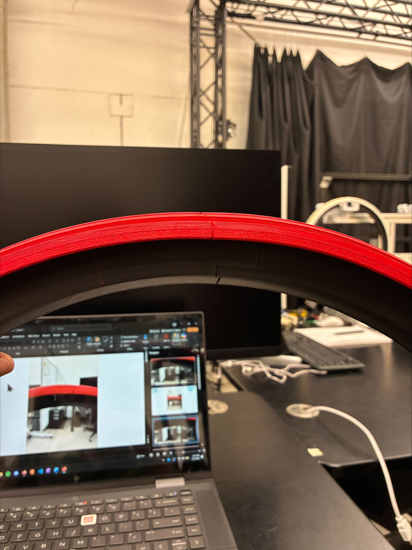
Deflection at joints is improved, curvature is much closer to circular, but bowing could still be reduced further.

Slide 2
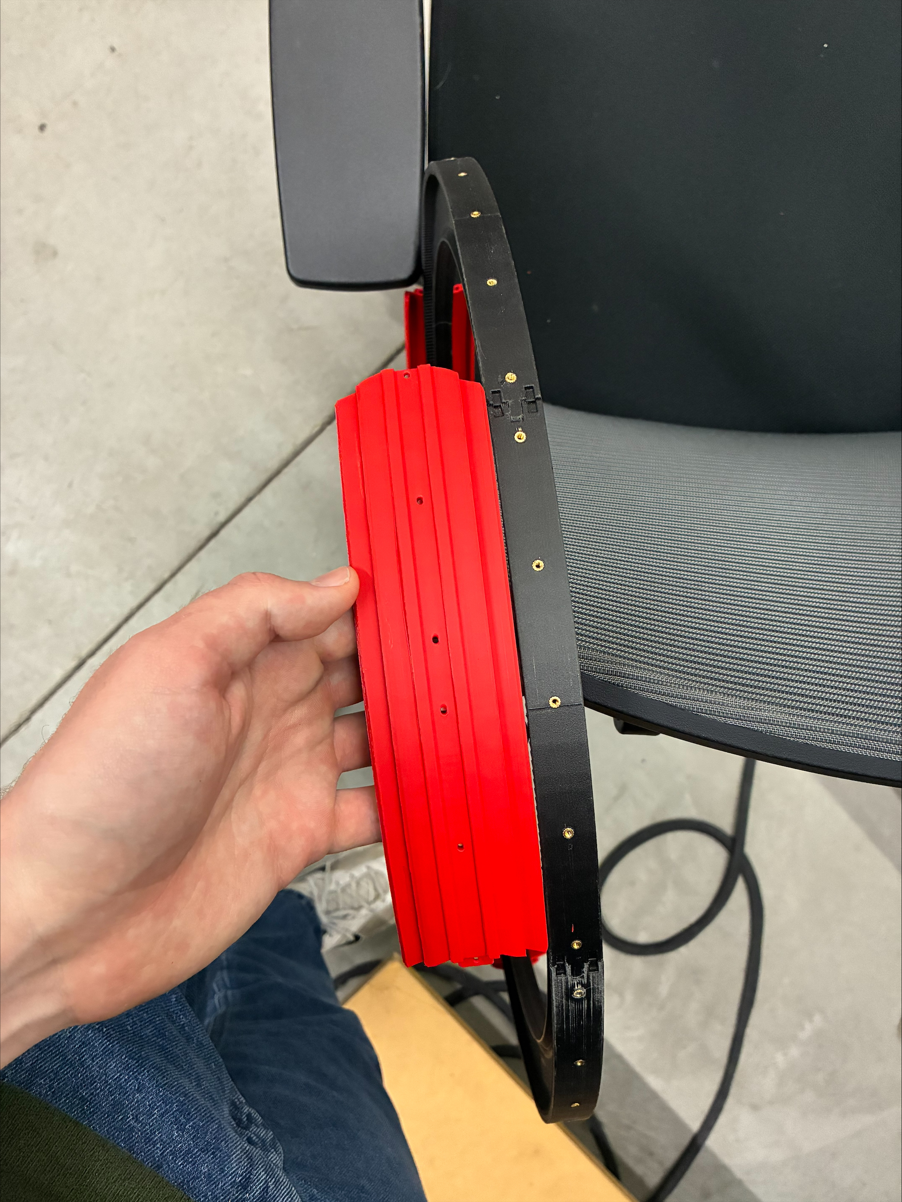
Close, but slightly misaligned
Fully misaligned
Fully misaligned
Good
Good
Good

Slide 3
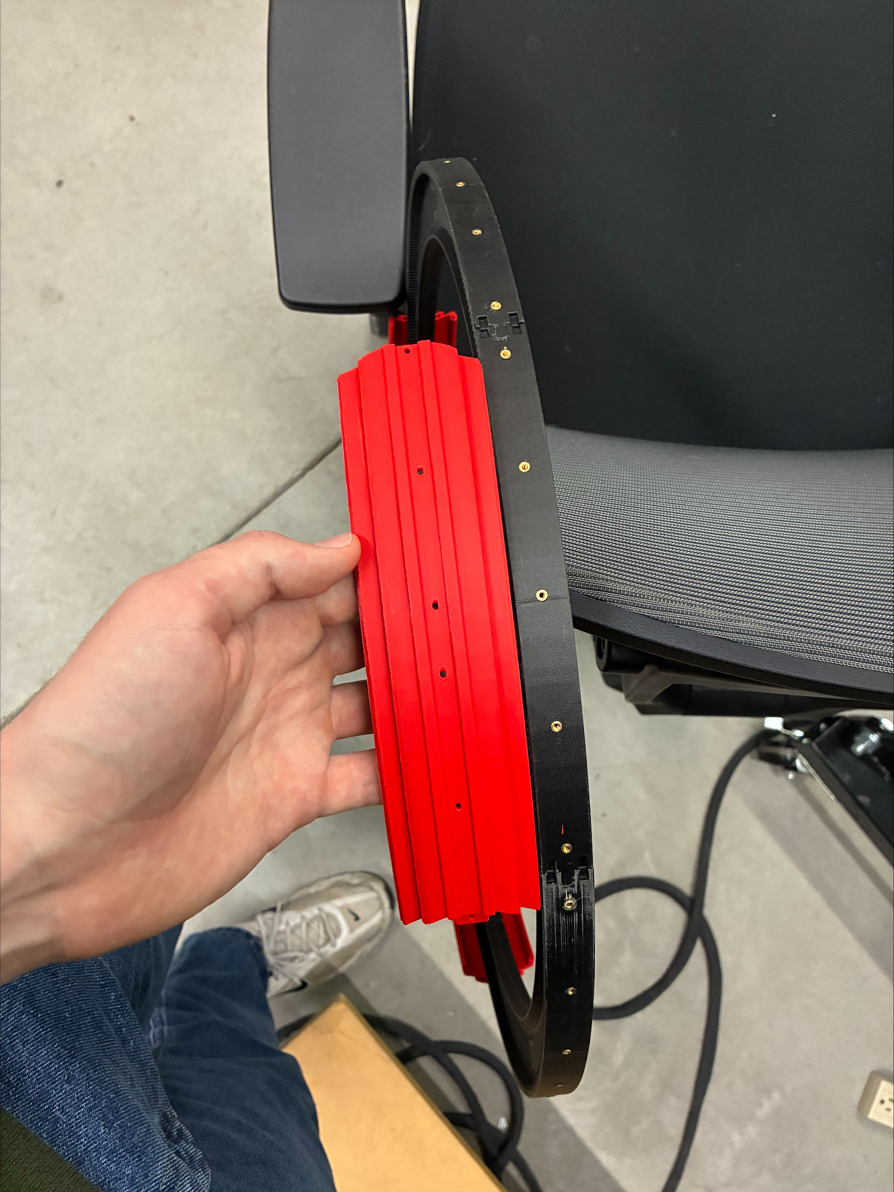
Close, but slightly misaligned
Good
Good
Fully misaligned
Fully misaligned
Good

Slide 4
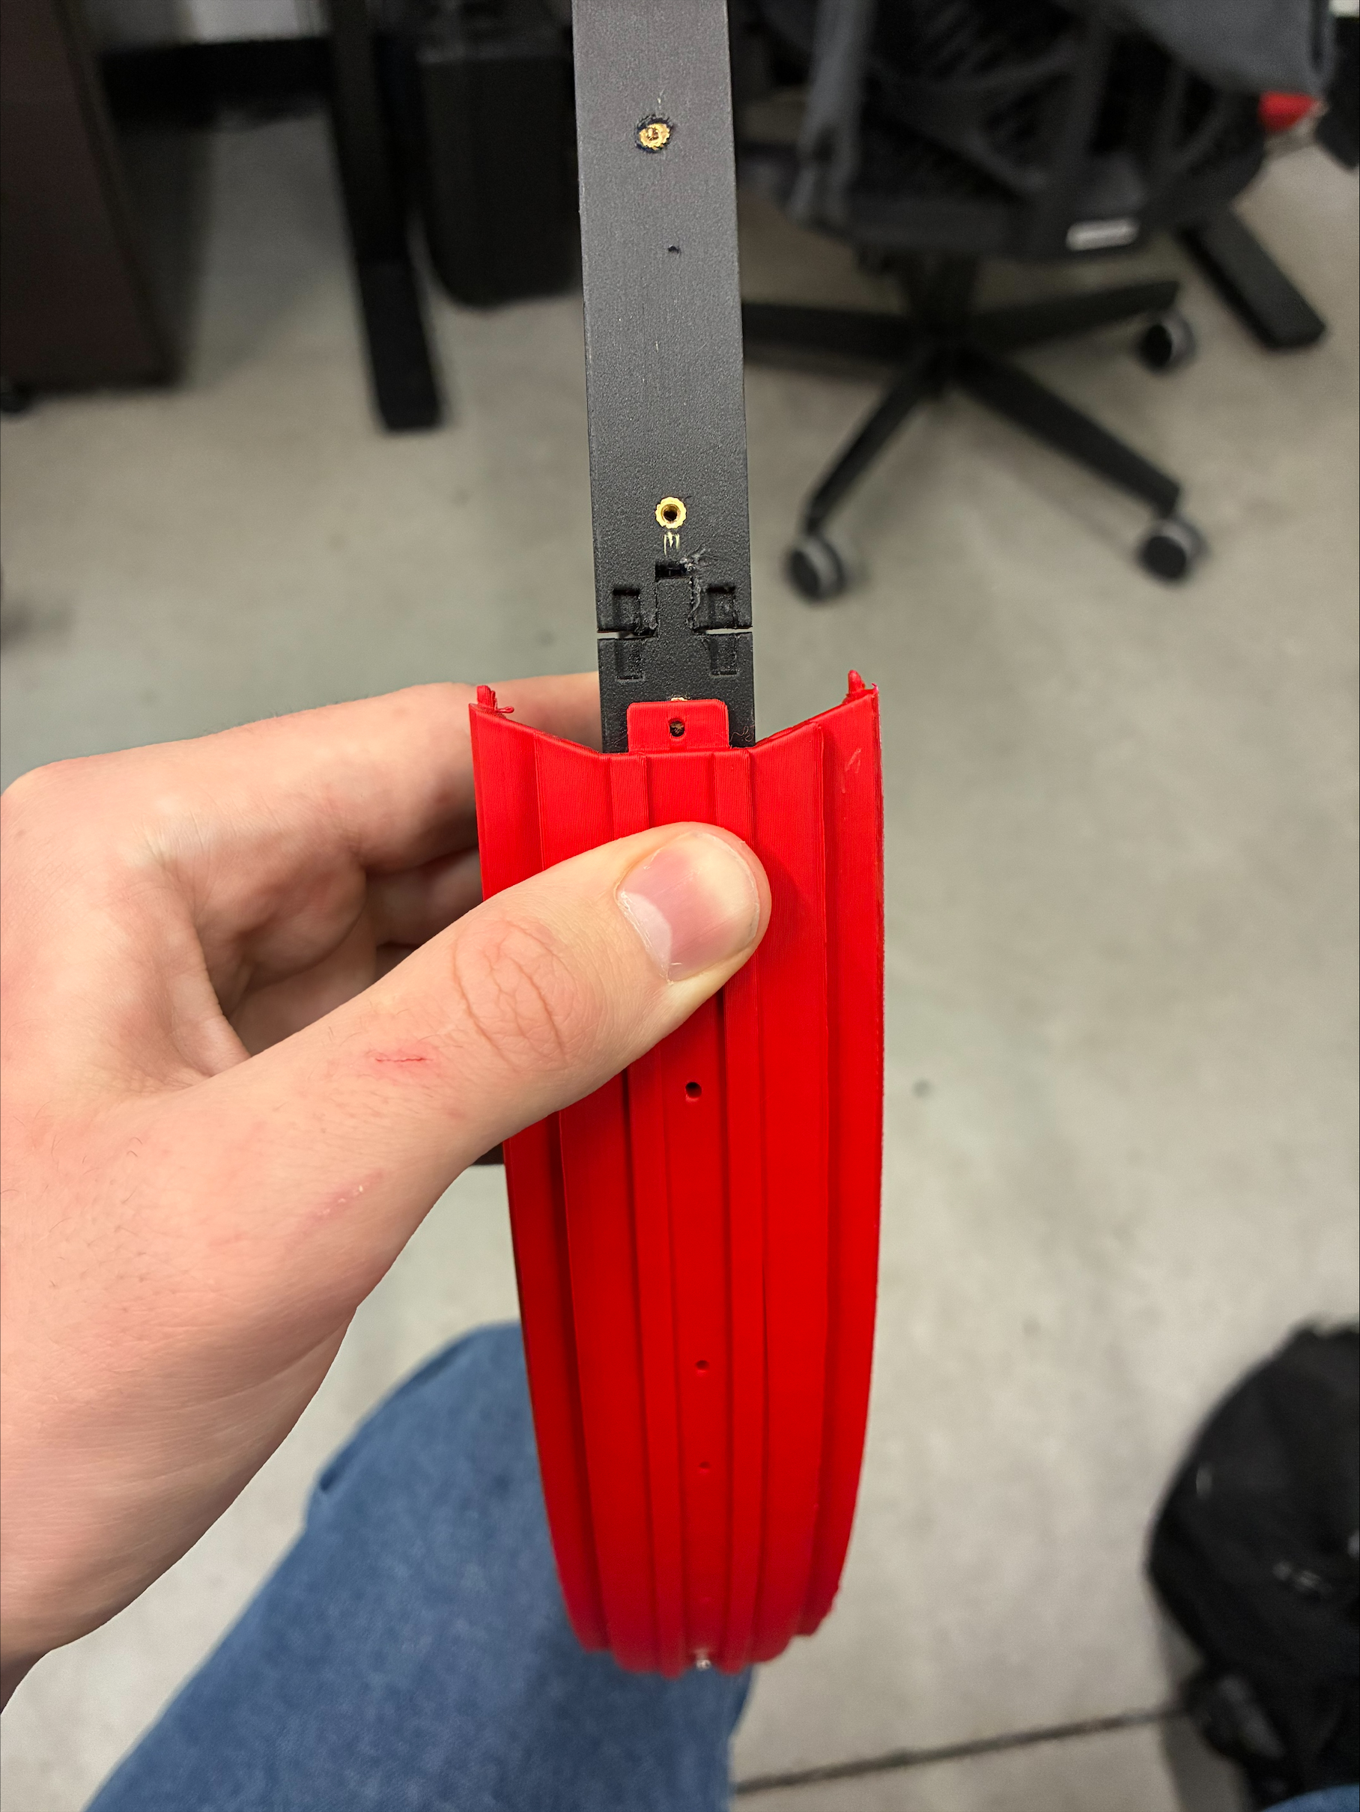
These holes should align, but they don’t, so the next piece will be slightly offset, leading to gaps in the outer ring

Slide 5
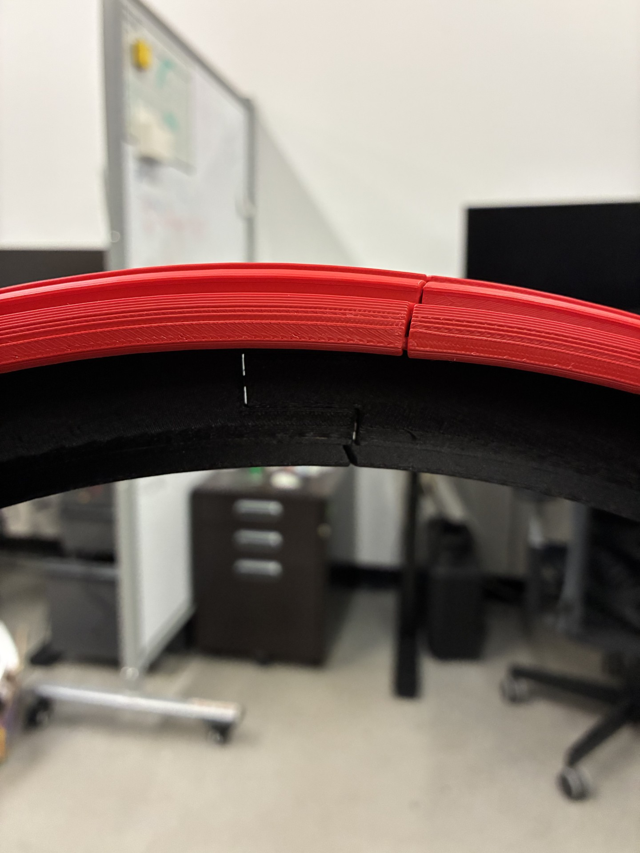
Screw misalignment causes gaps in inner ring, interrupting gear and rack meshing

